Slide 1
UHC in SOUTHEAST ASIA
Opportunities, Challenges for the HIV response
Jonas Bagas
Programme Officer, APCASO
jonasbagas@apcaso.org

Slide 2
Disclosure: No conflict of interest

Slide 3
UNIVERSAL HEALTH COVERAGE
UHC as a global goal: a turning point in the momentum for UHC
UHC as a bridge to other global agenda –health as right, as a vital element to eradicate poverty, to ensure access to medicines, and to build resilient and inclusive societies

Slide 4
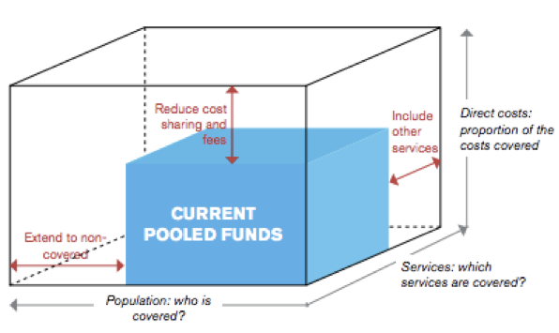
The uhc promise
Expanding access to health for all, while reducing direct cost.
What’s needed:
Building viable “risk pools”
A political consensus
Scaling up of public investment
A continuing expansion

Slide 5
UHC: Promise vs reality
UHC an ASEAN priority
Different financing modalities in the region
Inclusion of HIV into UHC already happening
Direct cost remains high

Slide 6
UHC in malaysia
Reporting “near universal coverage”
No insurance scheme but with federal govt subsidies for health
OOPs is high
HIV services covered for RM1-1: HTC, viral loal and CD4 testing, ART, STI and OI treatment, PMTCT

Slide 7
UHC in the philippines
Mixed schemes (govt subsidy, social health insurance, voluntary private insurance
High OOPs
A USD48 prepayment is required, but subsidized for indigents
HIV package worth USD600 a year, covering: ART & other HIV meds, viral load, CD4 testing, professional fees

Slide 8
UHC in the indonesia
Mixed schemes (SHI, govt subsidy, private sector)
High OOPs
HIV services covered: HTC, STI testing & tx, OI screening and tx
HIV treatment is directly subsidized / funded by donors

Slide 9
UHC in the indonesia
UHC frontrunner in the region
Three schemes: civil servant medical benefit scheme for govt employees, SS scheme for private sector, NHSO (direct govt subsidy) to catch those not covered by the other schemes
Target is to reduce OOPs to 30 baht for all diseases in all govt hospitals
No OOPs for all HIV services covered by NHSO
NHSO scheme procuring services from CSOs

Slide 10
CHALLENGES and opportunities
UHC is key to sustainability, but not a magic bullet
As a framework to demand for inclusion, but it should be based on equity, not on what’s politically palatable
UHC is not “integrate or perish”
Community systems & UHC – how can UHC “purchase” services from communities?
Yes to innovative financing, but public investment is extremely vital to expand UHC
We also need innovations in governance – how do we make it more participatory and accountable?
Donors have a role on UHC beyond financing

